Slide 1
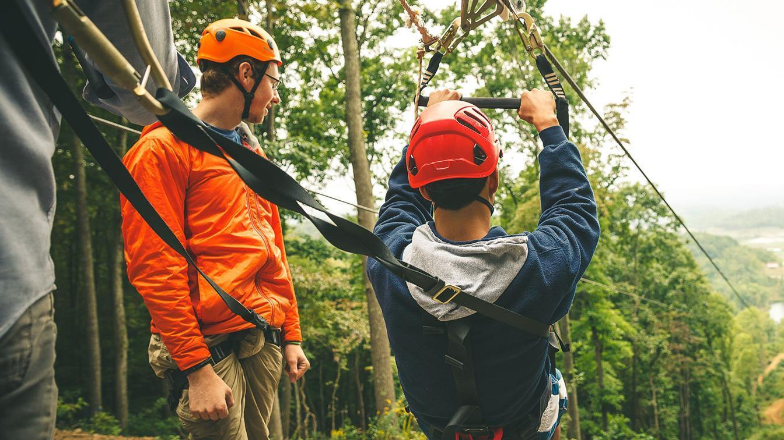
WHY WE ARE HERE
Youth Safety
A FIRESIDE CHAT ON
YOUTH SAFETY
DAN BEARD COUNCIL, BSA

Slide 2

AGENDA
Welcome
Safety of Our Youth
Current Scouting Safety Measures
Youth Protection
Impact of National Chapter 11
Additional Resources

Slide 3
INTRODUCTION
WHY WE ARE HERE
YOUTH SAFETY

Slide 4

THE BSA’S COMMITMENT TO YOUTH PROTECTION
Youth protection is our primary responsibility. It requires sustained vigilance from staff, volunteers and youth members.
We work every day to protect children through mandatory youth protection policies and procedures at every level of our organization.
Our youth protection measures include
extensive background checks and required
youth protection training for our adult leaders.

Slide 5
BEST PRACTICES IN YOUTH PROTECTION
As part of our commitment to continuous improvement, we constantly evaluate
and reinvest resources where needed to strengthen our policies.
We regularly consult with survivors, experts from law enforcement, child safety, psychology, and other relevant fields.
Experts have determined our youth protection policies are ahead of or in line with society’s knowledge of abuse and best practices for prevention.

Slide 6
CURRENT SAFETY MEASURES
IN SCOUTING

Slide 7


GENERAL YOUTH
SAFETY AWARENESS
Guide to Safe Scouting
Hazardous Weather Safety
Safe Camping
Climbing Safety
Safe Swimming
Cyber Chip
Anti-Bullying

Slide 8
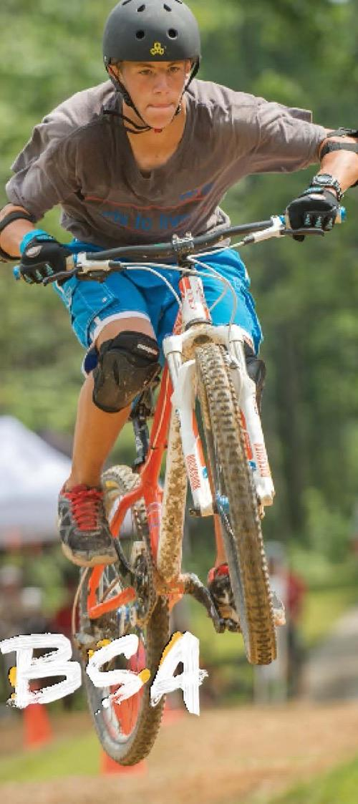
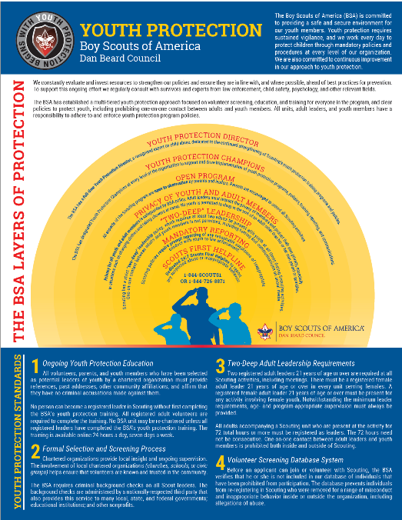
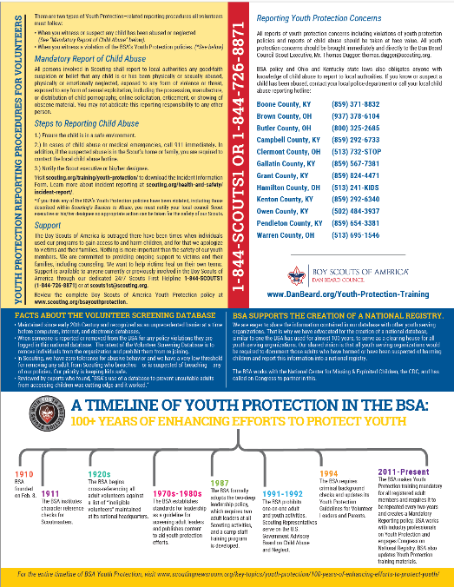
YOUTH PROTECTION OVERVIEW

Slide 9
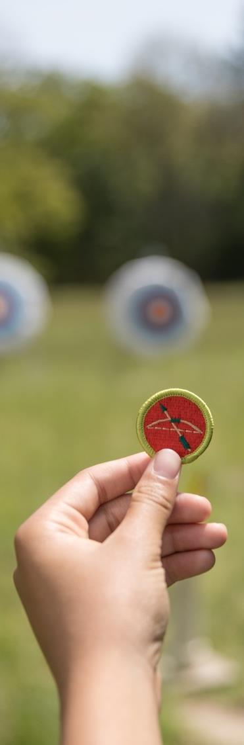
YOUTH PROTECTION OVERVIEW
Mandatory Reporting
2 Deep Leadership
Open Program
No use of digital devices where privacy is expected.
No hazing or bullying
Part of the Advancement Program
Youth Protection Training – The training is required to be completed every two years by any registered adult.

Slide 10

WHEN TO REPORT
There are two types of Youth Protection–related reporting procedures all volunteers must follow:
1) You witness or suspect any child has been abused or neglected
Mandatory reporting & Scouting policies require prompt reporting to law enforcement or child protective services.
2) When you witness a violation of the BSA’s Youth Protection policies.

Slide 11
STEPS TO REPORTING
Steps to Reporting:
1.) Ensure the child is in a safe environment.
2.) In cases of child abuse or medical emergencies, call 911 immediately. In addition, if the suspected abuse is in the Scout’s home or family, you are required to contact the local child abuse hotline.
3.) Notify the Scout executive or his/her designee.

Slide 12

YOUTH PROTECTION STANDARDS
We strive to prevent child abuse through comprehensive
policies and procedures including:
Ongoing youth protection education for all volunteers, parents, and youth members
A formal selection and screening process for adult leaders and staff that includes criminal background and
other checks
Requiring two or more adult leaders be present with youth at all times during Scouting activities
A Volunteer Screening Database system to prevent the registration of individuals who do not meet the BSA’s standards due to known or suspected abuse or misconduct inside or outside the organization

Slide 13
Youth Protection Parent’s Guides
ADULT LEADER SCREENING PROCESS
2) Criminal Background Checks & Volunteer Screening Database
1) Role of the Charter Partner in volunteer selection

Slide 14
INCIDENT OF ABUSE OR VIOLATIONS OF BSA SAFETY GUIDELINES
General Process for When an Incident of Abuse or a Violation of BSA Safety Rules is Reported:
Immediate Safety Concerns
Quickly gather as much information as possible
Immediate Action which would likely include:
Report to law enforcement or children services
National Office Involvement
Suspension
or
Membership Revocation
Support of Victim and Unit
Additional Review
Appeal Process

Slide 15
VOLUNTEER SCREENING DATABASE

Slide 16
FACTS ABOUT THE
VOLUNTEER SCREENING DATABASE
At a time before computers, the Internet, or electronic databases, the paper records kept by the BSA provided an unprecedented barrier to abuse when little else existed.
Maintained since the 1920’s to help keep kids safe.

Slide 17
FACTS ABOUT THE
VOLUNTEER SCREENING DATABASE
Findings from Dr. Janet Warren
Liaison to the FBI Behavioral Sciences Unit &
Professor of Psychiatry and Neurobehavioral Sciences at University of Virginia
  “Scouting is safe and the BSA’s use of a database to prevent unsuitable adults from accessing children was cutting edge and it worked.”
  “100% of all cases reported over the last 50 years were reported to law enforcement.”
  “The rate of incidence of reported abuse in BSA programs was far less than the rate of incidence in society as a whole.”
  “There is no evidence of a cover-up by the Boy Scouts of America.”

Slide 18
We are eager to share the information contained in our database with other youth serving organizations. That is why we have advocated for the creation of a national database, similar to one the BSA has used for almost 100 years, to serve as a clearing house for all youth serving organizations.
Our shared vision is that all youth serving organizations would be required to document those adults who have harmed or have been suspected of harming children and report this information into a national registry.
The BSA works with the National Center for Missing & Exploited Children, the CDC, and has called on Congress to partner in this.
THE BSA SUPPORTS THE CREATION OF A NATIONAL REGISTRY.

Slide 19
BSA NATIONAL COUNCIL
FINANCIAL CONSIDERATIONS

Slide 20
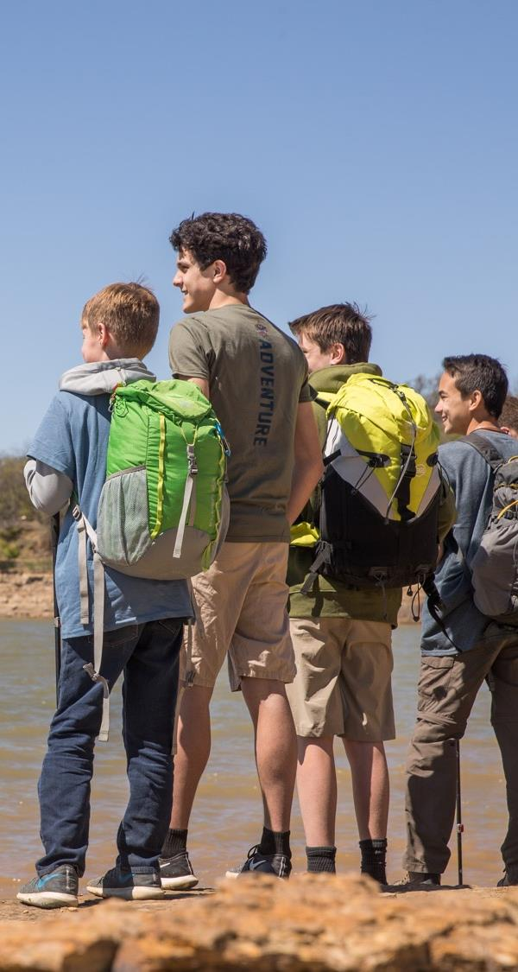
FINANCIAL CONSIDERATIONS
No decision has been made at this time.
The National Council is evaluating its financial abilities and is exploring the possibility of creating a Victims Fund through a financial reorganization.
When a Non-Profit files for chapter 11, they can keep the vital assets of the organization to help the mission continue forward.

Slide 21
WHY IS THIS HAPPENING NOW?
These financial issues are primarily due to youth protection lawsuits, 90% of which were cases between 1965-1985.
Recent stories stem from a concerted effort by plaintiffs’ attorneys suing the BSA National Office as statute of limitations and state laws have changed.

Slide 22
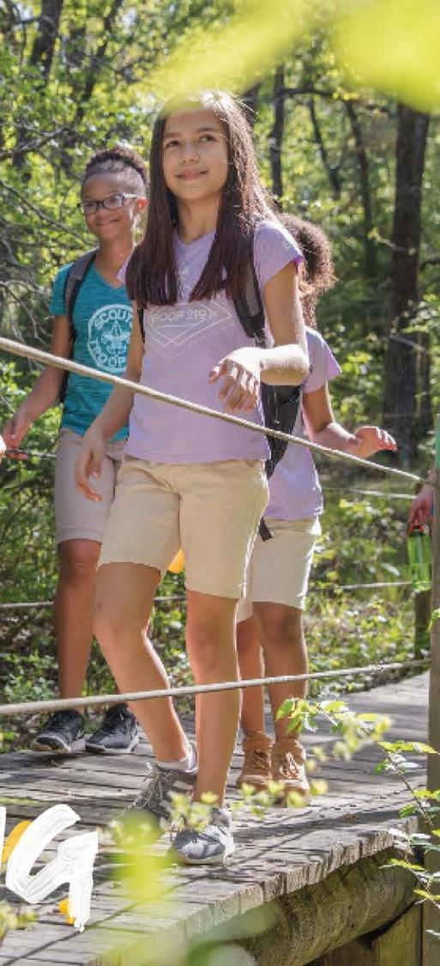
POTENTIAL IMPACT
The National office is considering this in order to properly support victims and protect the future of our youth leadership program that nationally serves 2.2 million youth.
Would allow for a Victim Fund that would help continue to support victims of abuse and distribute those funds equally.

Slide 23
POTENTIAL IMPACT
Dan Beard Council owns all of our camps, properties, service centers, and investments.
All donations made to Dan Beard Council stay local and go to support local Scout programs.

Slide 24
NEXT STEPS

Slide 25
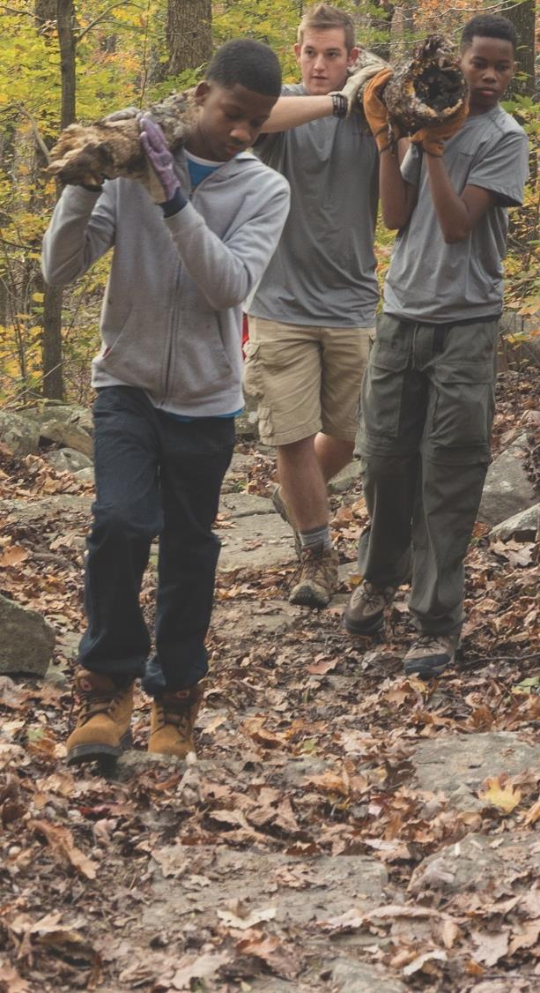
HOW CAN YOU HELP
Be an advocate, a voice, and a leader for both Scouting and Youth Protection.
Help to share the experiences and positive impact that Scouting has had on your family.

Slide 26
SAFETY KIT MATERIALS
Youth Protection Overview Flyer

Slide 27
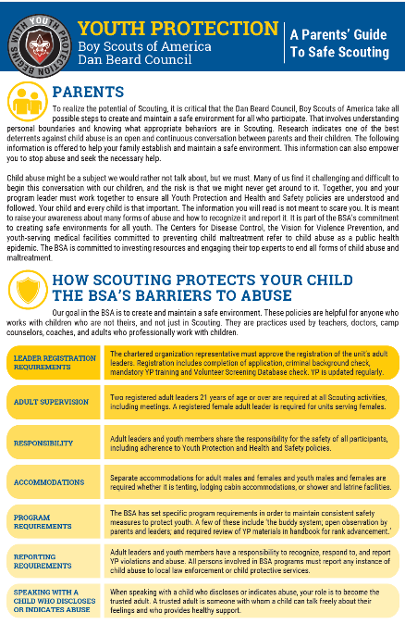
SAFETY KIT MATERIALS
Parent Safety Information Card

Slide 28
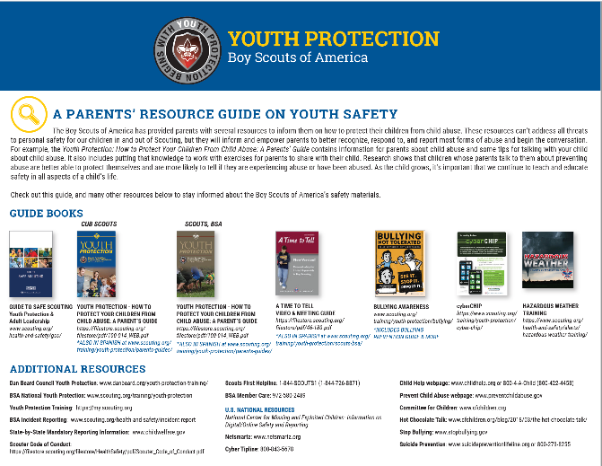
SAFETY KIT MATERIALS
Additional Safety Resources

Slide 29
SAFETY KIT MATERIALS
Quick Facts & Information Mini Tri-Fold

Slide 30

RESOURCES ONLINE
Materials will be available online at: www.danbeard.org/YouthProtection

